Slide 1
Reinforcement Learning
Agents, Environment, Rewards, Exploration
Introduction to Deep Learning: Class 7.1

Slide 2
Module outline
Class | Title | Main output
1 | Bandits, MDPs, Returns | agent/environment/reward
2 | Value Functions and Bellman Equations | Learning to solve a reinforcement learning problems by iteratively estimating the value of a state
3 | Monte Carlo, TD, SARSA, Q-Learning | On-policy vs off-policy, sampled experience
4 | Policy Gradients and REINFORCE | log-prob weighted by reward
5 | Actor-Critic and PPO | advantage, critic, clipping
6 | RLHF and GRPO | PPO/GRPO to LLM training

Slide 3
Agenda
1. What makes reinforcement learning different from supervised learning.
2. The agent-environment loop.
3. States, actions, rewards, trajectories, returns, and policies.
4. The exploration-vs-exploitation tradeoff.
5. Why bandits are the simplest RL-like problem.
6. How epsilon-greedy learning works.
7. How an LLM can be viewed as a policy.

Slide 4
Supervised vs Reinforcement Learning
Supervised Learning: Direct learning signal - Model output-> Compare to ground truth -> loss -> gradients -> weight update - Training data distribution is fixed
Reinforcement Learning: Model takes some action, which influences the environment. Feedback on the action may come later
Make a move in chess
Recommend an offer
Predict a token
Training data depends on agents interaction with the environment

Slide 5
Agent-Environment loop
state: what the agent sees
action: what the agent does
reward: scalar feedback
next state: what happens after the action

Slide 6
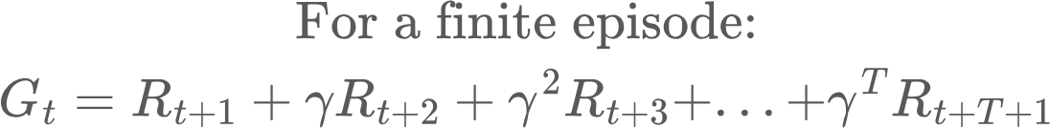
Episodes and Trajectories
Episode: Full (State, Action) sequence until some end state (eg., game over)
Return vs Reward. You get a reward potentially after every action. Return is the total (potentially discounted) reward for an episode

Slide 7
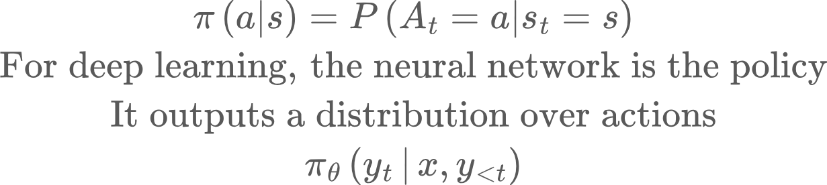
Policy
A policy defines a probability distribution over actions at a state

Slide 8
RL Objective
Find a policy that maximizes total expected return.
For a parameterized policy, find the parameters so that trajectories sampled from the policy have high expected returns

Slide 9
Multi-arm bandits
There are K arms. Each arm has an unknown pay-off distribution
Goal: Try the arms, learn their payoff and maximise rewards in the least number of tries
Reinforcement learning loop:
Start with an arm payoff estimate
Choose an arm (policy)
Get a reward
Update payoff estimate
Repeat
No state transitions here

Slide 10
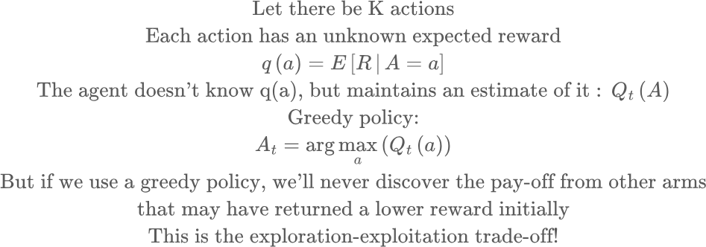
Multi-arm bandits

Slide 11
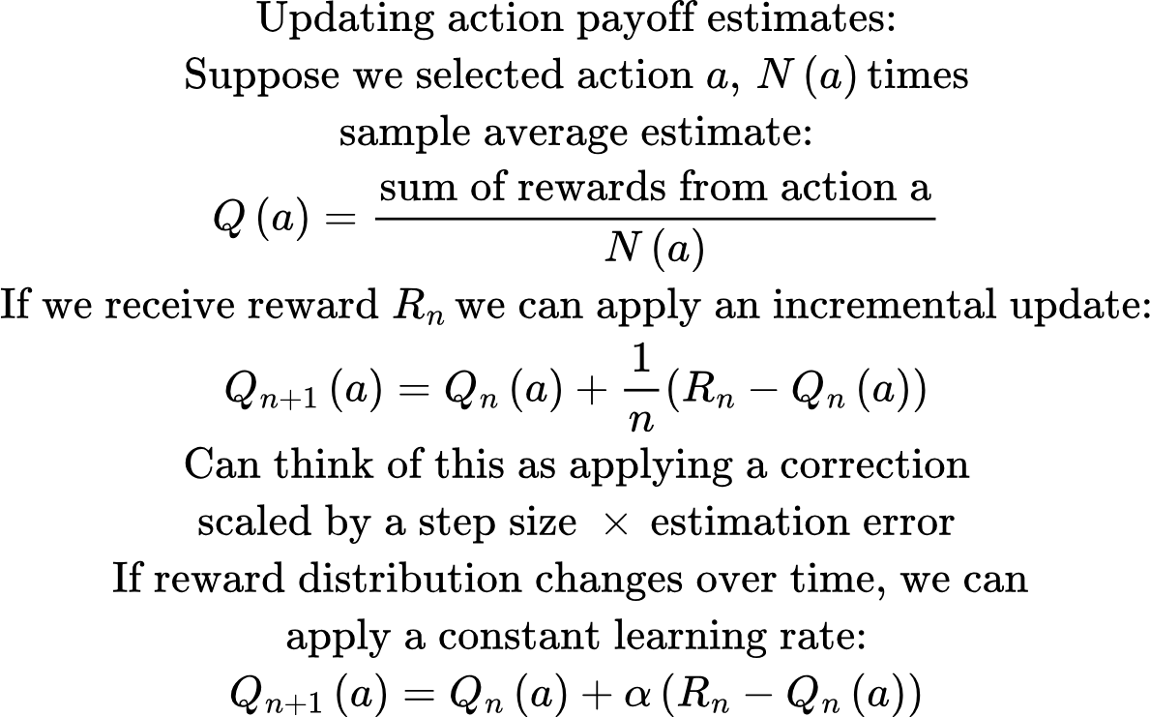
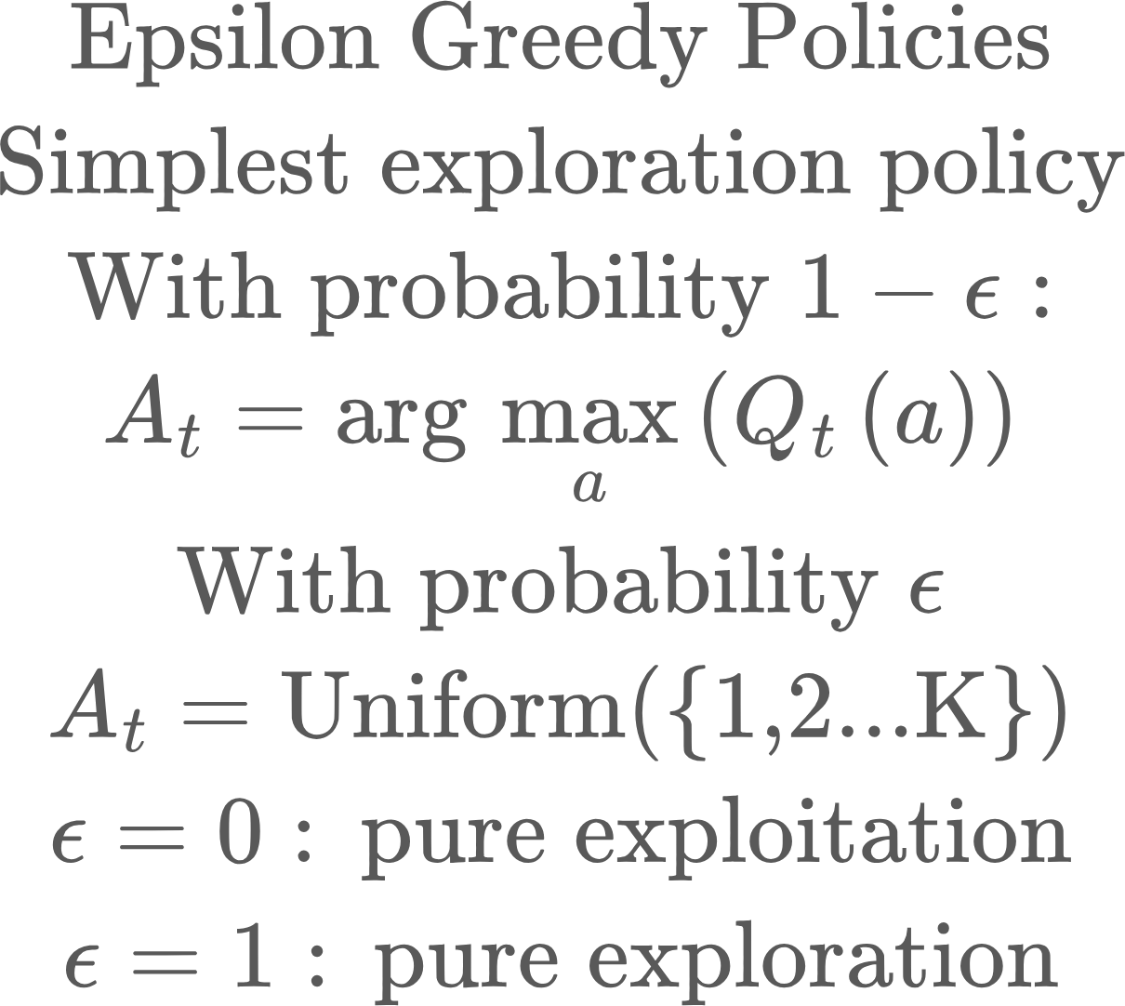
Multi-arm bandits

Slide 12
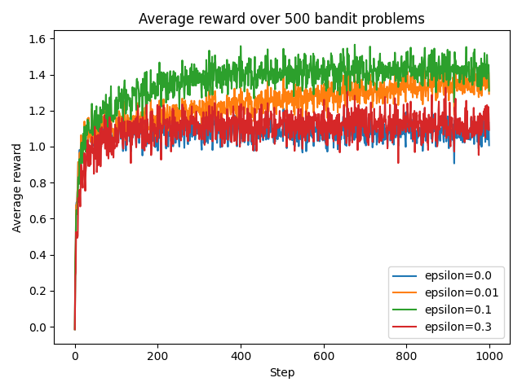
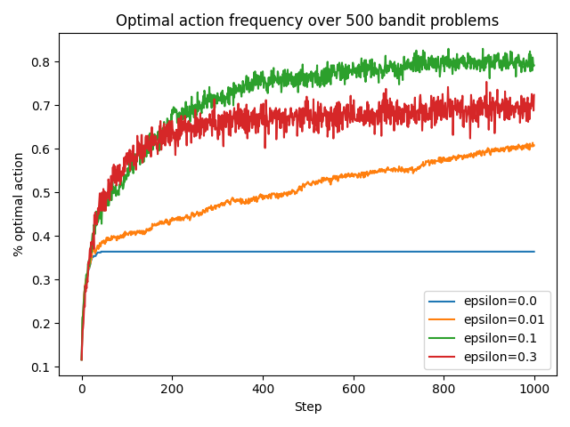
Multi-arm Bandit simulation

Slide 13
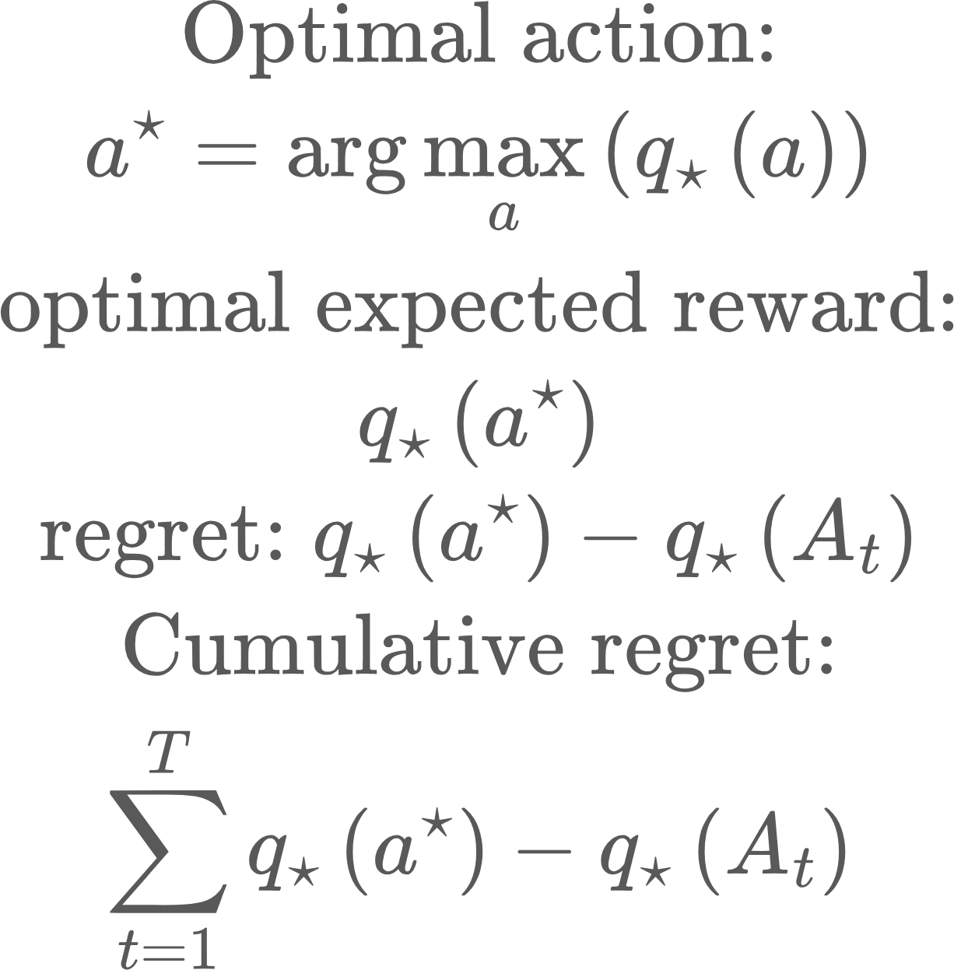
Regret
Regret measures how much reward we lost because we did not always pick the best action.

Slide 14
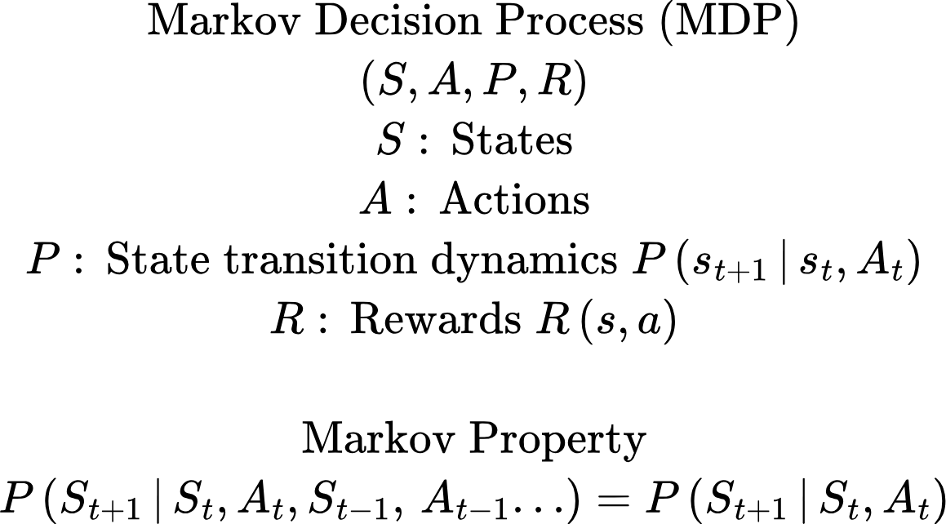
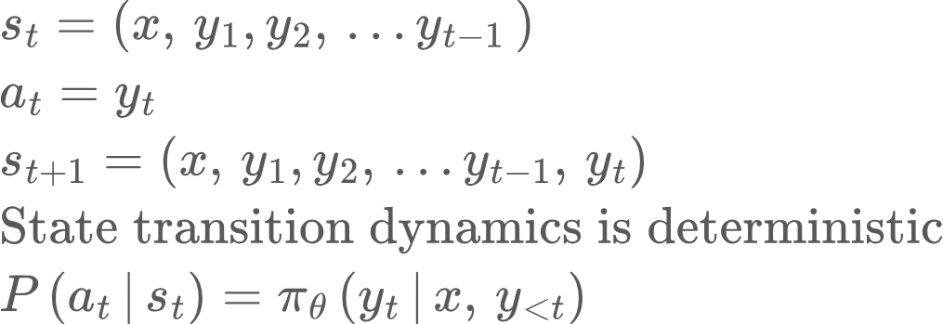
Markov Decision Process
LLMs
State: prompt + generated tokens so far
Action: next token
Policy: Language model
Reward: Human preference, reward score model, verifier score

Slide 15
RL for LLMs
Huge action space (vocabulary)
Delayed rewards
Long trajectories

Slide 16
Coding problems
Replace sample average update with constant step size update
Try for different values of alpha = [0.01, 0.1, 0.5]

